Slide 1
Getting Setup

Slide 2
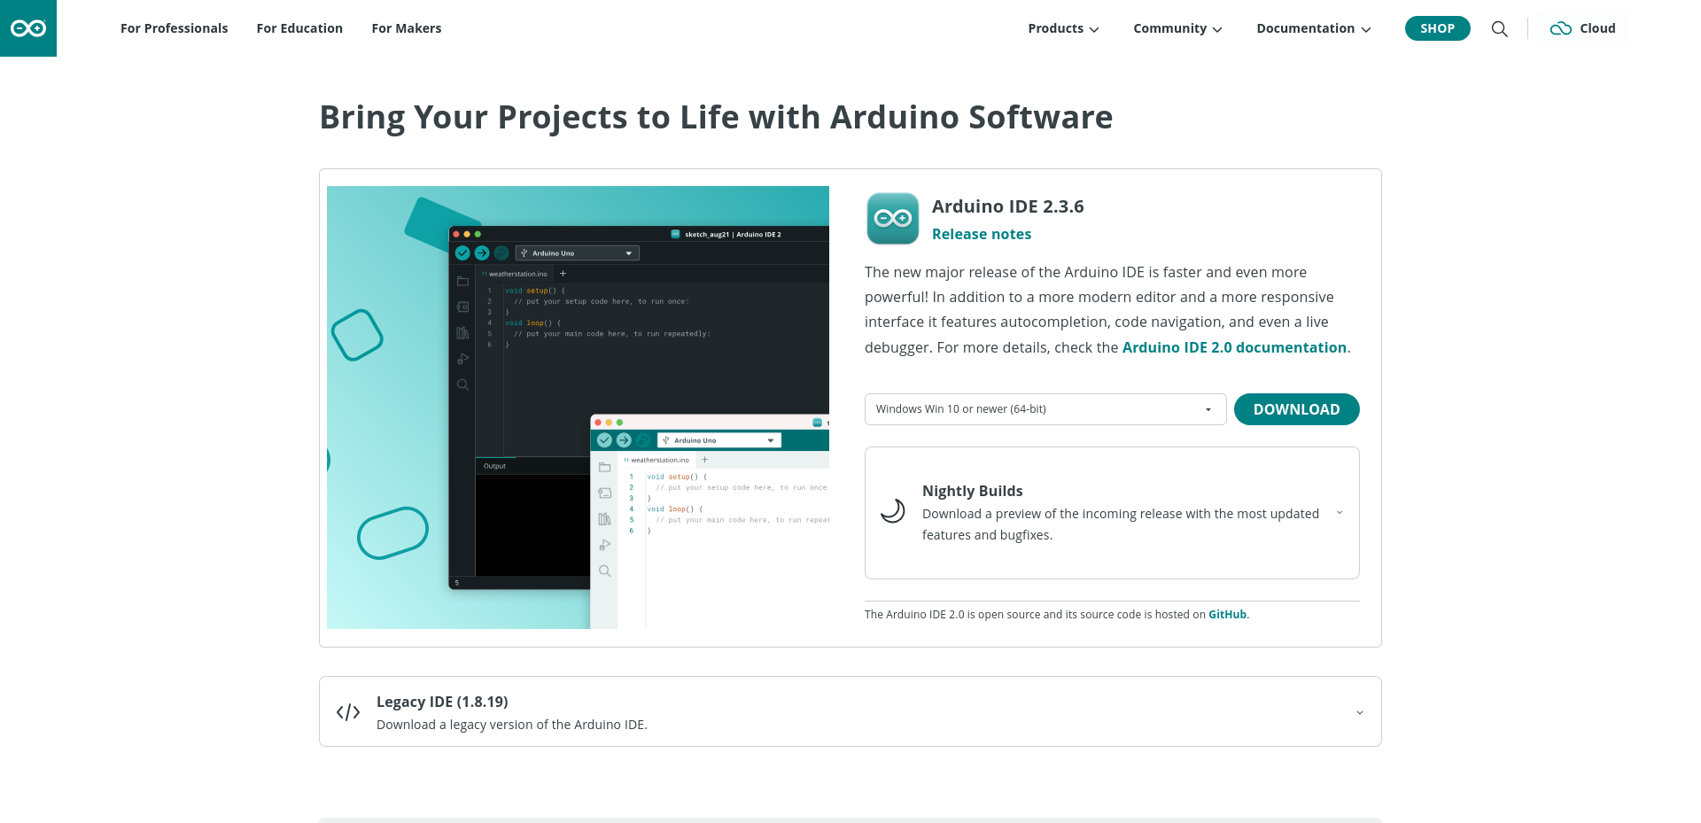
Installing Arduino Software
We will need to upload our code to the Arduino.
The first is the Arduino software found:
  www.arduino.cc/en/software
1. Select Windows or macOS
2. Download
1
2

Slide 3

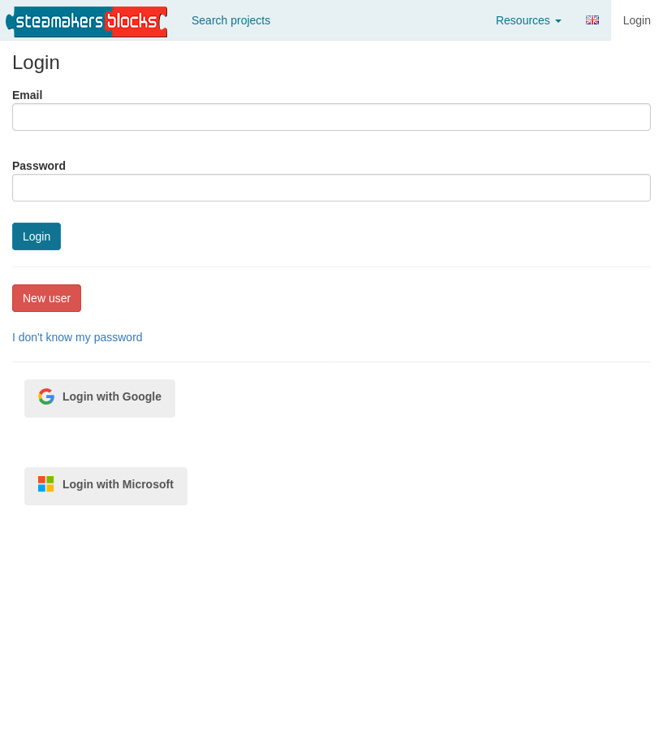
Create an Account
We need a place to create programs
Create an account at:
  www.steamakersblocks.com
1
2

